Slide 1
SOFTWARE ENGINEERING
By
V.Ravi KishoreM.Tech(CSE)M.Tech(SE).,PhD
Associate.Professor
Dept of Computer Science and Engineering
Aditya Engineering College(A)
Surampalem.

Slide 2
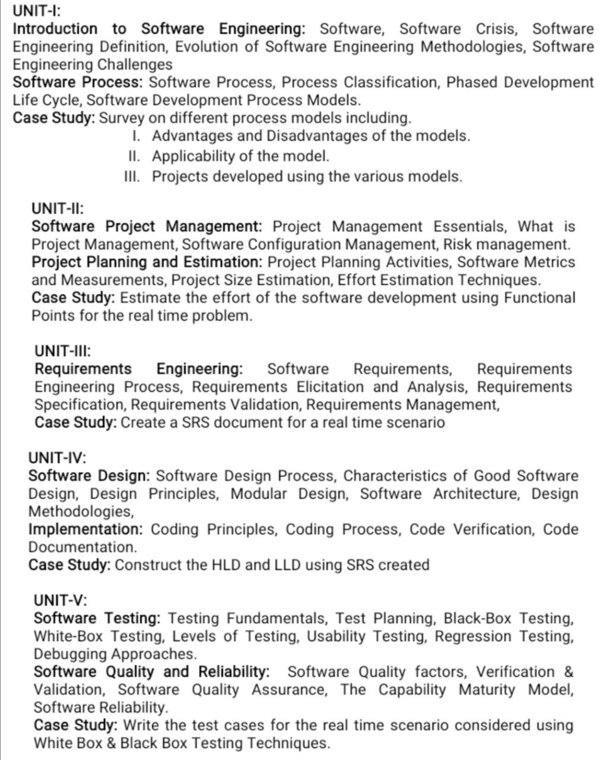

Slide 3
Introduction to Software Engineering
Software
Software Crisis
Software Engineering Definition
Evolution of Software Engineering Technologies
Software Engineering Challenges

Slide 4
Software Engineering
Engineering:
The process of designing and building something that serves a particular purpose.
Software:
It is a program or set of programs containing instructions which provide desired functionality and it also comprises of data structures that enable the program to manipulate information.

Slide 5
Software Engineering Definition:
Software Engineering is defines as systematic approach which we aim for developing a Quality Software.
This systematic approach not only deals with development but also maintenance operation.

Slide 6
Dual Role of Software :
As a Product: It delivers the computing potential of a H/W.
i) enables the h/w to deliver the expected functionality.
ii) Sets as information transformer.
a) Business Information :Query Retrieval s/w basis (Market Basket Analysis)
b) Personal Information : Salary Statement Generation of an EMP.
As a vehicle for delivering Product:
Helps in creation and control of other programs.
Eg: OS

Slide 7
Why Software Engg is so important:
Enables us to build complex systems s/w in a timely manner.
Ensuring high Quality S/W.
Imposes discipline to work that can become chaotic.
What is Work Product: (Result/Outcome)
Software Engineer:
The Set of Programs, the content along with the documentation that is part of s/w.
User/Customer:
The functionality is delivered by the s/w that improves user experience.

Slide 8
Software Engg Focuses ON??:
Quality (while s/w development)
Functional and Non Functional
Maintainability:
1.After the s/w has been developed and delivered.
2.Should be easily enhanced and adapt to changing requirements whenever required.

Slide 9
Types of softwares:
System Software
Application software
Engg/Scientific software
Embedded Software
Artificial Software
Legacy Software
Web/mobile software
Real world software

Slide 10
System Software : that provides a platform for others to run.
Eg: OS, compiler, interpreter.
Application Software:
1.They serve or developed for particular purpose.
(Business Application.i.e payroll system, ERP)
2. Personal needs (increase user experience)
Engineering /Scientific software:
Complex numerical problems are solved.
Eg: Astronomical S/W, Genetic Analysis).
Embedded software: Provide limited features & functionality.
Eg: Microwave ovens, dash board displays, plane cockpit control panel.

Slide 11
Artificial Intelligence Software:
Induce human like intelligence in machines.
Complex algorithms which are non-numeric.
Eg: Robotics, Interactive Game playing.
Legacy Software:
Very old and traditional software.
These are changed from time to time.
They do not have a good quality
Web (They run on Browsers: online editing/ Mobile software: (They run on mobiles)
Eg: Games, scan
Real world Software: Are those that control, monitor and analyze world events in real time)
Eg: weather forecasting, satellite software.

Slide 12
Difference between Software and Hardware:
SOFTWARE | HARDWARE
SW does not wear out, it deteriorates. | Hardware wears out with time
Software(Developed by programmers) is a logical(intangible) unit. | High failure rate early life cycle.
There are no spare parts for software (S/W modules may be dependent on each other). | Defects corrected & failure rate drops to a steady level for some time.
Problem Statement.( it may not be complete and clear). | With time failure rate rises again this phase is referred as wear out phase.
Requirements | Spare parts
Multiple copies | Multiple copies

Slide 13
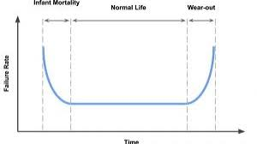
F
R
ACTUAL CURVE
IDLE CURVE
TIME
SOFTWARE
HARDWARE

Slide 14
Software Crisis:
It is term used in early days of computing science for the difficulty of writing useful efficient program in required time.
Causes of software crisis:
Project running is over budget.
Project running overtime.
The software very inefficient.
Low quality .
S/W did not meet the requirements.

Slide 15
DIAGRAMATIC REPRESENTATION:
Increasing the Demand.
Increasing complexity.
Increasing challenges.
Software Crisis
Same work force
Same Methods
Same work force
Same methods
Same Tools

Slide 16
Evolution of Software Engineering Methodologies:
A software engineering methodology is a set of procedures followed from the beginning to the completion of the development process.
2. Software engineering methodologies have evolved with increasing complexities in programming and advancements in programming technologies.
3.The most popular software methodologies are:
Exploratory methodology
Structure-oriented methodology
Data-structure-oriented methodology
Object-oriented methodology
Component-based development methodology

Slide 17
Evolution of Software Engineering Methodologies:
Component programming
Programming technology
Component oriented
Object-oriented programming
CBD models
Object oriented
Parallel programming
OOA/OOD models
Data structure oriented
High-level programming
JSD models
Structure oriented
Unstructured programming
SA/SD models
Exploratory methodology
State models
Programming complexities

Slide 18
Exploratory Methodology :
1.Exploratory methodology –Specifies whose requirements are initially unclear.
2.It involves step-by-step programming.
3.Unable to meet reliability, extensibility, and maintainability goals.
4.Maintenance is very difficult and costly because of the lack of documentation and multiplicity of changes in the initial proposal.

Slide 19
Structure-Oriented Methodology :
1.Structured methodology focuses on procedural approach, which concentrates on developing functions or procedures.
2.It has three basic elements, Sequence, Selection, Iteration.
3.Structure-oriented methodology uses a variety of notations, such as
Data Flow Diagrams (DFD),
data dictionary,
Control Flow Graphs (CFG),
Entity Relationship (ER) diagrams, etc., to design the solution of the software.
4.Examples C, COBOL, BASIC, FORTRAN, etc.

Slide 20
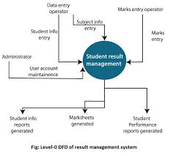
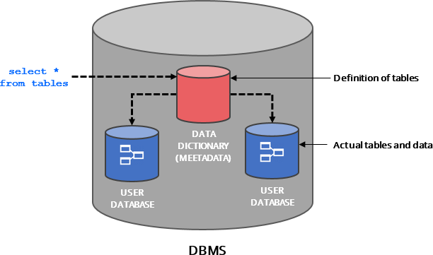

Slide 21
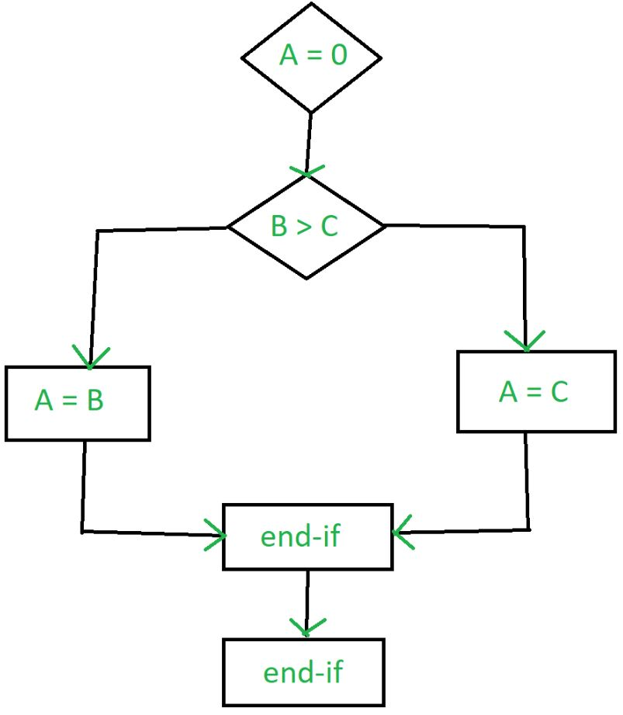
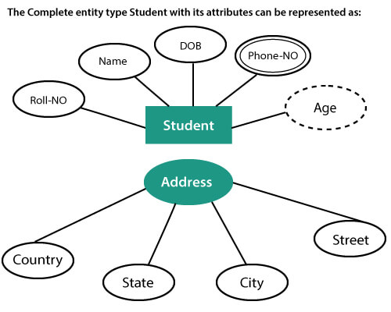

Slide 22
Data-Structure-Oriented Methodology
1.Data-structure-oriented methodology concentrates more on designing data structures rather than on procedures and control.
2.Jackson Structured Design (JSD) methodology developed by Michael Jackson in 1970 is a famous data-structure-oriented methodology that expresses how functionality fits in with the real world.
3.JSD is a useful methodology for concurrent software, real time software, microcode, and for programming parallel computers.
4.Though JSD is good for shaping real world scenario, it is complex and difficult to understand.

Slide 23
Object-Oriented Methodology :
1.Object-oriented methodology emphasizes the use of data rather than functions.
2.Data and procedures are built around these objects. The real world entities are treated as objects. The objects having characteristics in common are grouped into classes.
3.An object involves properties and methods
4.Object-oriented methodology has three important concepts: modularity, abstraction, and encapsulation.
5.Object-Oriented Analysis (OOA) and Object-Oriented Design (OOD) techniques are used in object-oriented methodology.
6.OOA is used to understand the requirements by identifying objects and classes, their relationships to other classes, their attributes, and the inheritance relationships among them.
6.OOD creates object models and maps the real world situation into the software structure.
7.Object-oriented methodology is the latest and the most widely-used method for the development of applications in a variety of domains.

Slide 24
Component-Based Development Methodology :
1.Component-Based Development (CBD) -for communication among different stakeholders.
2.CBD is a system analysis and design methodology that has evolved from the object-oriented methodology.
3.It is largely based on its focus on reuse.
4.Its proponents promise faster time to market, cost reduction, better quality, flexibility, and scalability.

Slide 25
Software Engineering Challenges:
Problem Understanding
Quality and Productivity
Cycle Time and Cost
Reliability
Change and Maintenance
Usability and Reusability
Repeatability and Process Maturity
Estimation and Planning

Slide 26
Software Process
Software Process
Process Classification
Software Development Life Cycle
Software Development Process Models

Slide 27
Software Process:
A software process is a coherent set of activities, procedures, policies, organizational structures, constraints, technologies, and artifacts that are needed to develop software products.

Slide 28
Process , Project & Product:
1.A software process is a complex entity in which each activity is executed with the supporting tools and techniques.
2.A software project is an entity, with defined start and end, in which a software process is being used.
3.A product is the outcome of a software project produced through processes.
4.Software process, project, and products are interrelated to each other for the development of software.

Slide 29
Process , Project & Product
Process
Used
Produces
Product
Project
Used in
Resources

Slide 30
A Software Process Model
A software process model is a generic representation of a software process instantiated for each specific project.

Slide 31
Generic Representation of Process Model
Definition phase
Umbrella activities
Development phase
Implementation phase

Slide 32
Generic Representation of Process Model
Definition phase -problem and planning.
The activities may include problem formulation, problem analysis, system engineering, and project planning for the process.
Development phase -solution of the problem.
The main activities of this phase are designing the architecture and algorithms of the system, writing codes, and testing the software.
Implementation phase: Deployment, change management, defect removal, and maintenance activities are performed in this phase.
The activities are project management, quality assurance, configuration management, risk management, work products preparation and deployment, and process improvement.

Slide 33
Software Development Life Cycle
Collectively, these activities are called the software development life cycle (SDLC) or simply software life cycle and each of these activities are called life cycle phase.
The SDLC provides a framework that encompasses the activities performed to develop and maintain software.
Some of these models are waterfall, prototyping, spiral, incremental, agile process, RUP process model, and so on.

Slide 34
Software Life Cycle Activities
Project initiation
Analysis
Design
Coding
Maintenance
Testing
Deployment
Feasibility Study

Slide 35
Software Life Cycle Activities
Project Initiation /Feasibility Study
1.Project initiation involves preliminary investigation, feasibility study, and a project plan.
2.Preliminary investigation (PI)

Slide 36
Software Life Cycle Activities
Requirements Analysis
1.The requirement analysis phase consists of three main activities: requirements elicitation, requirements specification, and requirements verification and validation.

Slide 37
Software Life Cycle Activities
Software Design
The design phase has two aspects: physical design and logical design.

Slide 38
Software Life Cycle Activities
Coding
1.This code is written in a formal language called a programming language, such as assembly language, C++, Java, etc.

Slide 39
Software Life Cycle Activities
Testing
1.Testing is performed at different levels: unit testing, integration testing, system testing, and acceptance testing.
2.Various special tests are also performed to check the functionality of the system, such as recovery testing, performance testing, load testing, security testing, and so on.
5.Testing is an important technique of software quality assurance.

Slide 40
Software Life Cycle Activities
Deployment
1.The purpose of software deployment is to make the software available for operational use.
2.It includes various activities to make a system available for assembly and to transfer it to the customer site.

Slide 41
Software Life Cycle Activities
Maintenance
The maintenance activities can be classified as adaptive (changes in the software environment), perfective (new user requirements), corrective (fixing errors), preventive (prevent problems in the future).

Slide 42
Software Development Process Models
Classical waterfall model
Iterative waterfall model
Prototyping model
Incremental model
Spiral model
Agile process model
RUP process model

Slide 43
Classical Waterfall Model
The waterfall model is a classical development process model proposed by R. W. Royce in 1970.
In this model, software development proceeds through an orderly sequence of transitions from one phase to the next in order (like a waterfall).
It is the simplest and the most widely used model in development.
This model produces standard outputs at the end of every phase, which is called work products.
This model was enhanced with a feedback process, which is referred to as an iterative model.

Slide 44
Project Initiation /Feasibility study
Feasibility report
Requirements analysis
Requirement document
Software design
Design document
Coding
Programs
Testing
Test reports
Deployment
Release reports
Maintenance

Slide 45
Classical Waterfall Model
Advantages
1.The main advantage of the waterfall model is that it is easy to understand and implement.
2.Due to the straightforward organization of phases, it is fit for other engineering process models, such as civil, mechanical, etc.
3.It is a document-driven process that can help new people to transfer knowledge.
4.Milestones and deliverables at each stage can be used to monitor the progress of the project.
5.This model works well on large and mature products. It is not well suited for small teams and projects.

Slide 46
Classical Waterfall Model
Disadvantages
1.The model assumes that the requirements will not change during the project.
2.Sometimes, it is unrealistic to expect accurate requirements early in a project.
3.It is very difficult to estimate the time and cost in the waterfall model.
4.There may be difference of opinions among the specialists because there are specialized teams for each individual phase.
5.The people mentally ready to work in a phase will have to wait until its previous phase is completed.

Slide 47
Iterative Waterfall Model
The iterative waterfall model is an extended waterfall model with backtracking at each phase to its preceding phases.
The life cycle phases are similar to those in the classical waterfall model. The only difference is backtracking of phases on detection of errors at any stage.
The errors can come at any stage of the development life cycle.
Once a defect is detected there is a need to go back to the phase where it was introduced.
On defect detection at the source, some of the work performed during that phase and all the subsequent phases may be revised.

Slide 48
Project Initiation /Feasibility study
Feasibility report
Requirements analysis
Requirement document
Software design
Design document
Coding
Programs
Testing and integration
Test reports
Deployment
Release reports
Operation and Maintenance
Backtracking

Slide 49
Prototyping Model
Prototyping is an alternative in which partial working software (i.e. a prototype) is initially developed instead of developing the final product.
IEEE defines prototyping as “a type of development in which emphasis is placed on developing prototypes early in the development process to permit early feedback and analysis in support of the development process.”
Prototype development is a toy implementation, which provides a chance to the customer to give feedback for final product development.
A prototype provides limited functionalities, low reliability, and insufficient performance as compared to the actual software.
A prototype helps customer to understand the requirements that can further reduce the possibility of requirement changes.

Slide 50
Project Initiation /Feasibility study
Quick
design
Refine requirements
Build prototype
Incorporate customer suggestions
Customer evaluation
Customer satisfied
Design
Coding
Testing
Deployment
Maintenance

Slide 51
Incremental Model
The incremental model is an intuitive(T/F) approach to the waterfall model with fewer restrictions.
The activities are performed in the same order as in the waterfall model, but they are conducted in several iterations.
Each iteration releases a fully functional work product by providing additional functionalities in successive releases.
The final iteration releases the complete product .

Slide 52
Incremental Model
Iteration 1
Release 1
Design
Coding
Testing
Deployment
FS/project Initiation
Iteration 2
Release 2
Requirement analysis
Design
Coding
Testing
Deployment
maintenance
…
…
Iteration N
Release N
Design
Coding
Testing
Deployment

Slide 53
Spiral Model
The spiral model is an iterative software development approach, which was proposed by Boehm in 1988.
In this model, activities are organized as a spiral with many loops.
Each loop in the spiral represents a phase of software development.
The exact number of loops in the spiral is not fixed.
The main focus of this model is identification and resolution of potential risks (product risks, project risks, and process risks).

Slide 54
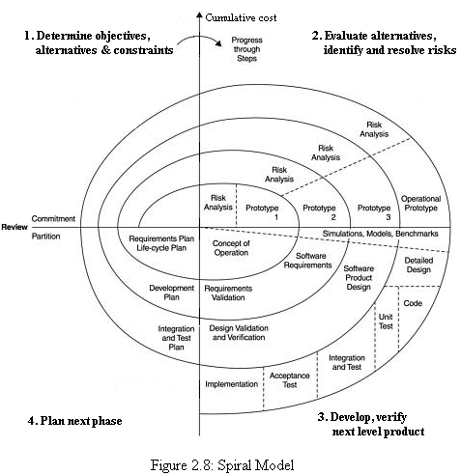
Spiral Model
F.S/P.I

Slide 55
Agile Process Model
The agile process model is a group of software development methodologies based on iterative and incremental development.
In February 2001, 17 software developers published the manifesto of agile software development to define the approach.
Some of the manifesto's authors formed the agile alliance. The manifesto of agile software development is as follows:
“We are uncovering better ways of developing software by doing it and helping others do it.” This work focuses to value the following:
a. Individuals and interactions over processes and tools
b. Working software over comprehensive documentation
c. Customer collaboration over contract negotiation
d. Responding to change over following a plan

Slide 56
Agile Process Model
Agile software development methods
extreme programming (XP),
Scrum,
dynamic systems development method (DSDM),
adaptive software development (ASD),
Crystal, feature-driven development (FDD),
test-driven development (TDD),
pair programming,
refactoring,
Internet speed development, and so on

Slide 57
Extreme Programming
Simple design CRC cards(class,responsibilities, collaborations
Spike solutions prototype
User stories, acceptance criteria, iteration plan
Simple problem –potential solutions
Design
R/A
Coding
F.S
Planning
Refactoring
Deployment
Pair programming
Test
which two programmers work together at one workstation. One, the driver, writes code
maintainance
Unit test and continuous integration
Release
Acceptance testing

Slide 58
Agile Process Model
Scrum
1.Scrum is another popular agile framework with a set of roles and practices.
2.It is also an iterative process with the idea of time boxing, which is known as sprint.
3.Scrum relies on a self-organizing, cross-functional team.
4.There are two roles in the Scrum process: pigs and chickens.
5.Pigs group includes product owner, Scrum master, and a Scrum team.
6.The group “chickens” involves users, stakeholders, and managers
7.In the Scrum process, product backlog describes "what" will be built, which is managed by the product owner.

Slide 59
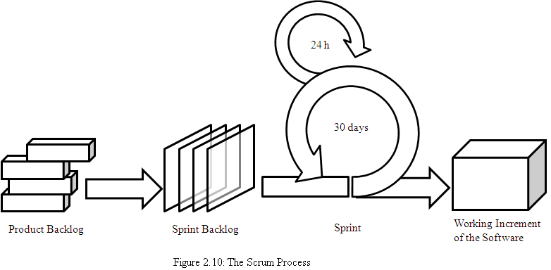
Scrum

Slide 60
Scrum
Benefits and drawbacks to Scrum process
1.It is a completely developed and tested feature in short iterations.
2.It is a simple process with clearly defined rules. It increases productivity and the self-organizing team member carries a lot of responsibility.
3.It improves communication and combination with extreme programming.
4.It has no written documentation and sometimes violation of responsibilities.

Slide 61
RUP Process Model
The Rational Unified Process (RUP) is a use-case driven, architecture-centric, iterative, and incremental process model.
The RUP focuses on creating and maintaining models rather than documentation.
It is derived from Unified Modeling Language (UML), which is an industry-standard language that helps to clearly communicate requirements, architectures, and designs.
The RUP is supported by tools which automate most of the activities of the process.
The RUP divides the development cycle into four consecutive phases; namely, inception, elaboration, construction, and transition.
FS/RA Design Coding Testing Deployment /Maintainence

Slide 62
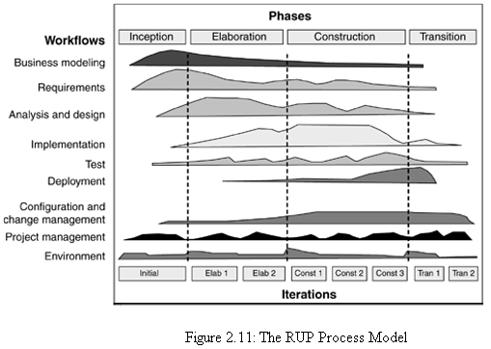
RUP Process Model

Slide 63
Software Myths
Myth is a false belief (not reality/Interpretations).
Management Myths
Customer’s Myths
Practitioner’s Myths

Slide 64
Management Myths (budget,schedules,quality)
Myth1 : We already have a book full of standards and procedures for building s/w, won’t that provide my people with everything they need to know.
Myth2 : My people have the state of art development tools, after all , we buy them the newest computers.
Myth3: If we get behind schedule, we can add more programmers and catch up.
Myth4: If I decide to outsource the s/w project to a third party, I can just relax and let the that firm build it.

Slide 65
Customer’s Myths (request from stakeholders,marketing /sales,a technical group,next desk,outside)
Myth1: A general statement of objectives is sufficient to begin writing programs - we can fill the details later.
Myth2 : Project requirements continually change, but change can be easily accommodated because s/w is flexible.

Slide 66
Practitioner’s Myths (fostered by over 50 years of programming culture)
Myth1: Once we write the program and get it to work, our job is done.
Myth2: Until I get the program running, I have no way of assessing its quality.
Myth3: The only deliverable work product for a successful project is a working program.
Myth4: Software Engineering will make us create voluminous & unnecessary documentation and will invariably slow us down.

